Slide 1
Lab 2
How to install windows 10 on a virtual machine
Instructor Name:
Fahad Burhan Ahmad

Slide 2
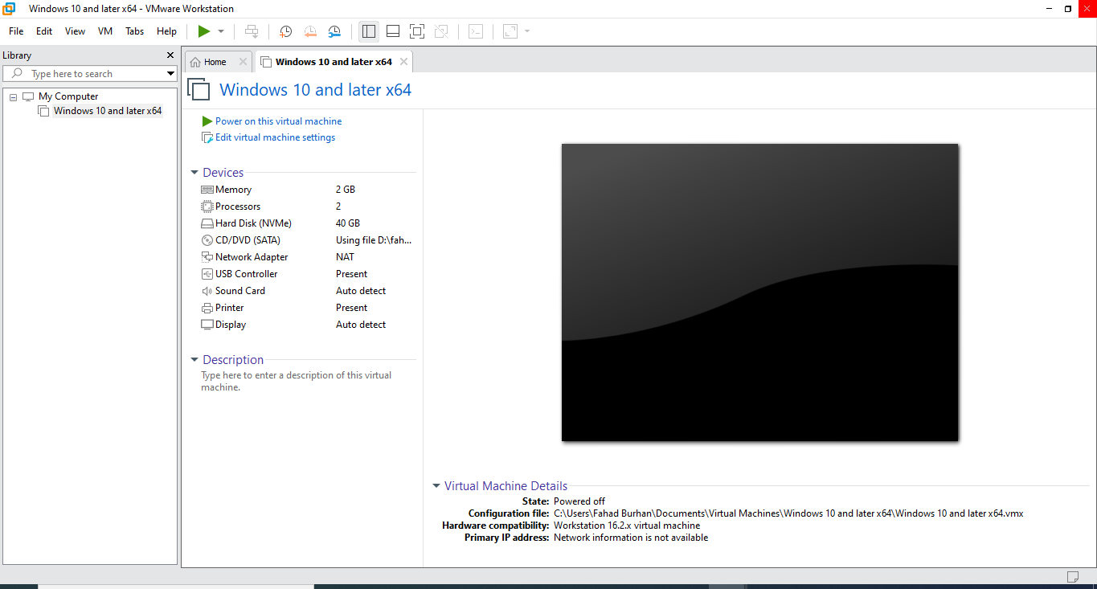
Open VMware software
Double click on VMware software that you already install on your machine
You will find the just like below user interface on your desktop.

Slide 3
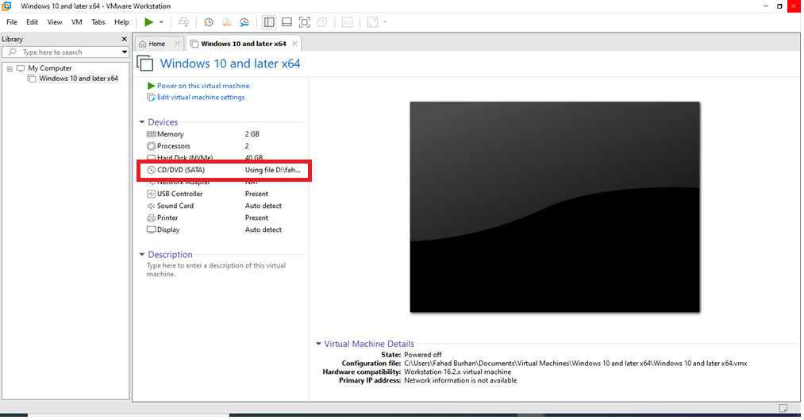
Click on the CD/dvd (SATA) red color highlighted box
You all are required to create virtual machine for Linux and Windows 7

Slide 4
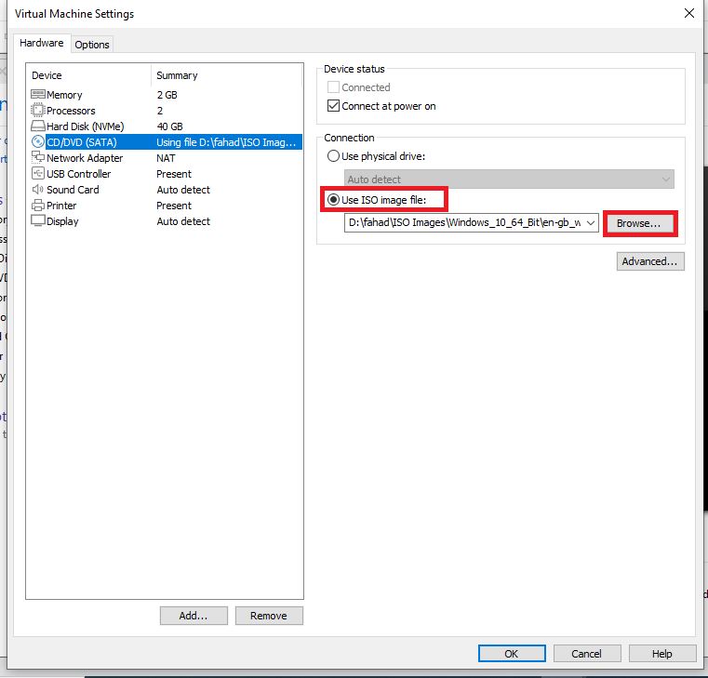
Choose the use iso image file: option and then click on browse button to provide the path of Windows 10 ISO file and click on ok

Slide 5
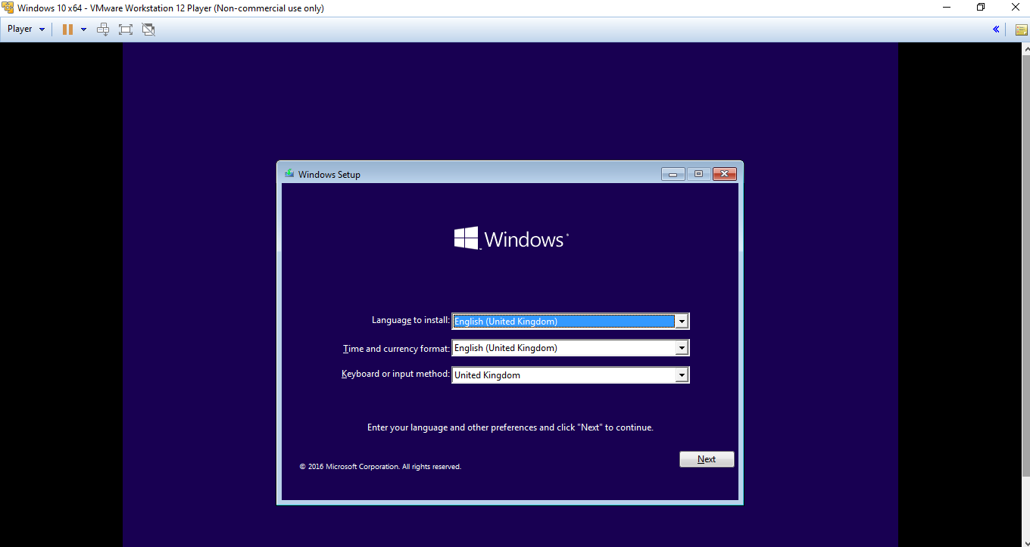
Change the Time and date format and keyboard or input method in to United State and click on next

Slide 6
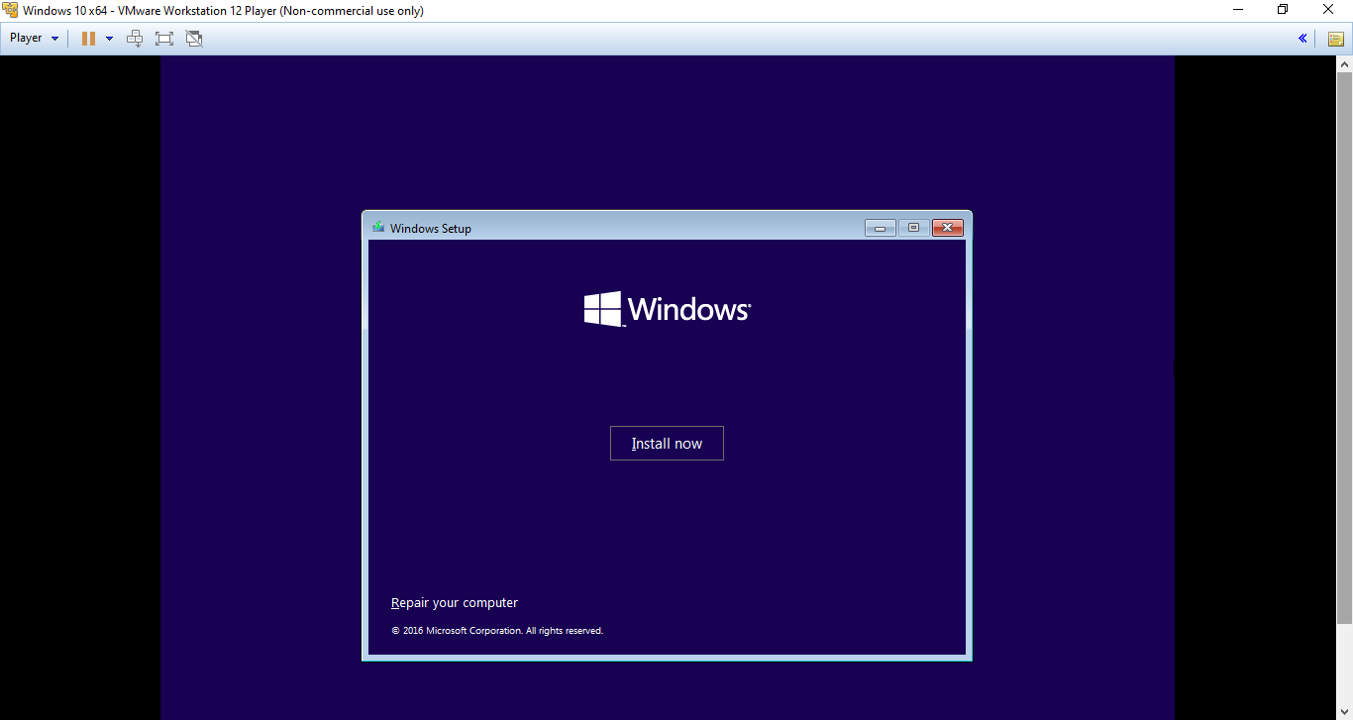
Click on install now

Slide 7
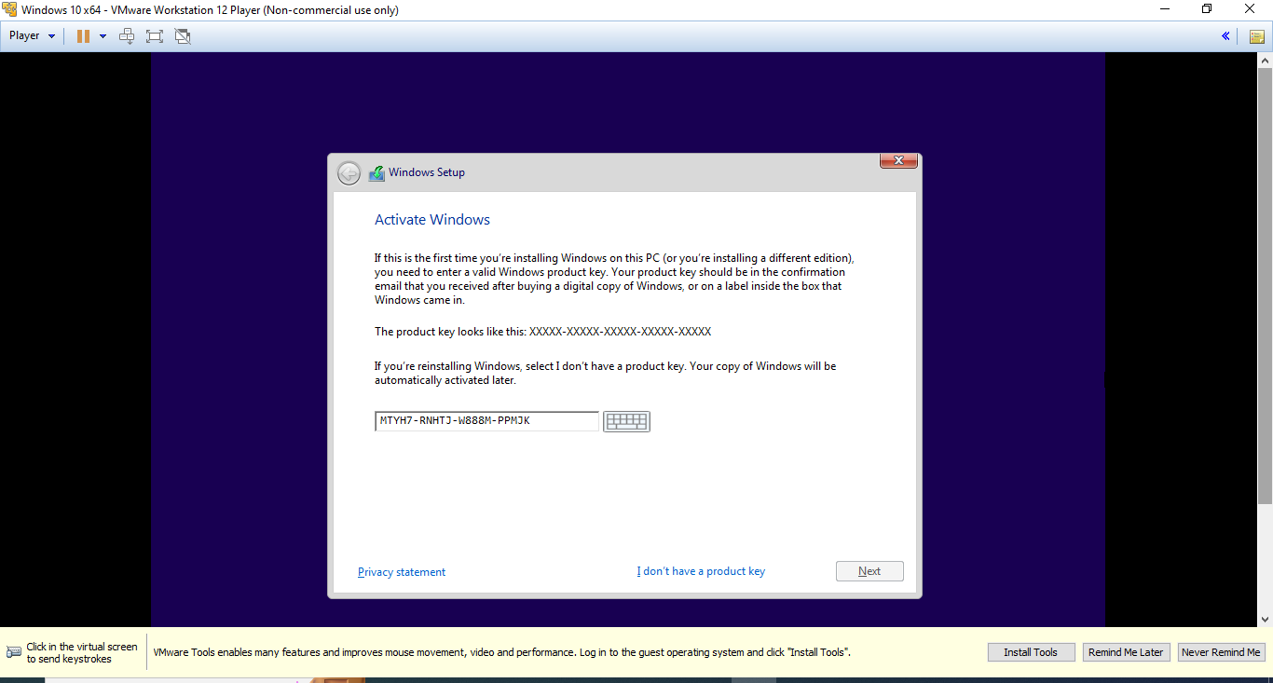
Enter the product key for windows 10 or Click on I don’t have a product key and click next

Slide 8
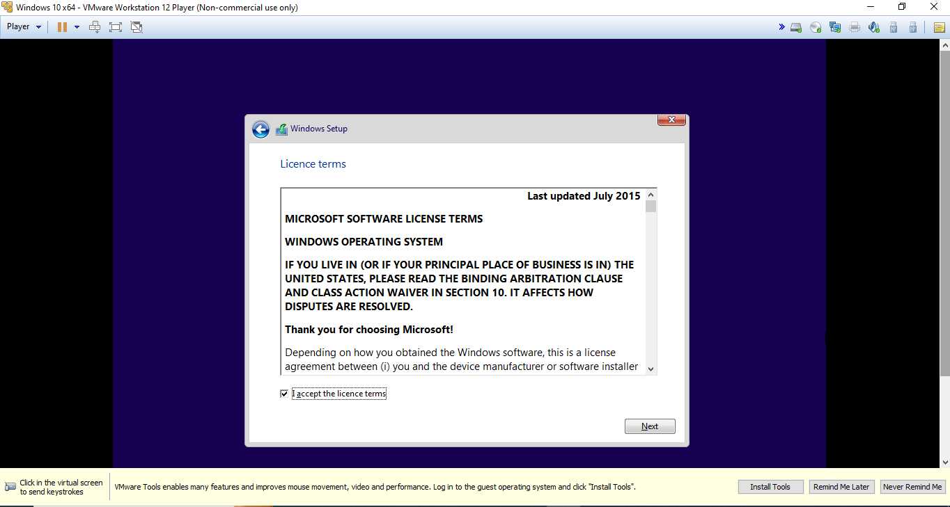
Check on I accept the license term

Slide 9
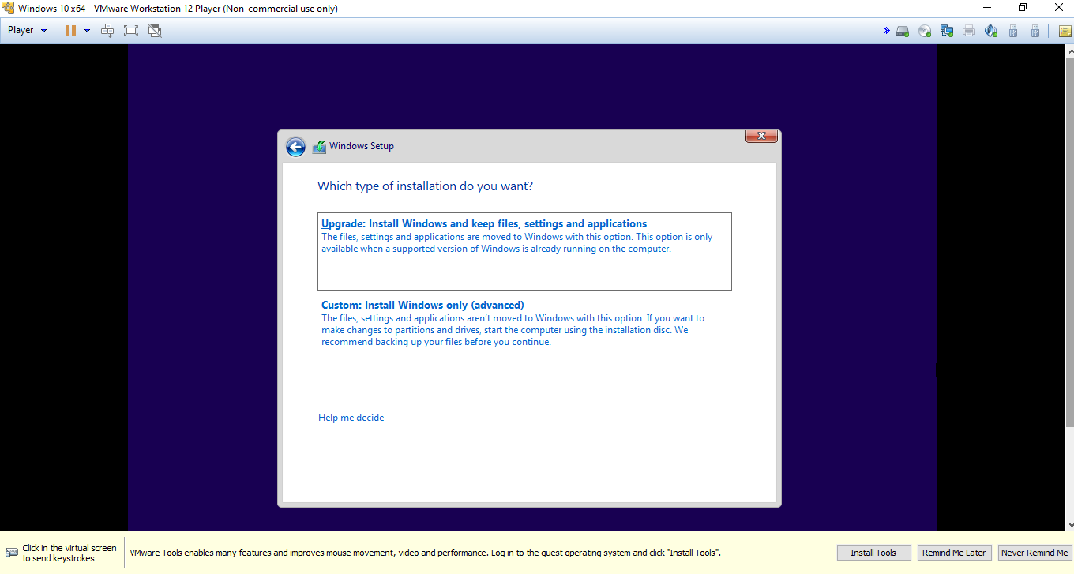
Choose the custom install

Slide 10
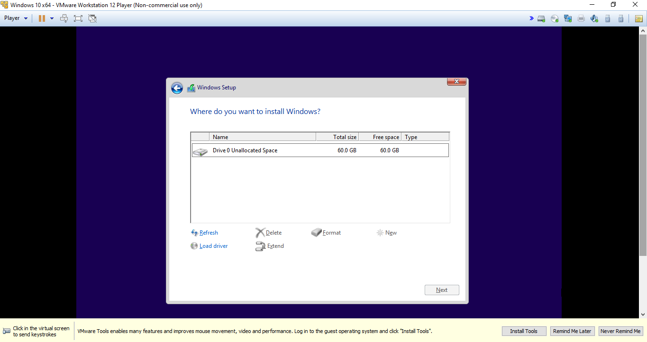
Overall disk space that is available for partition. But its depend upon the space. If we have 500 GB to 1 TB disk then I recommend to make partition

Slide 11
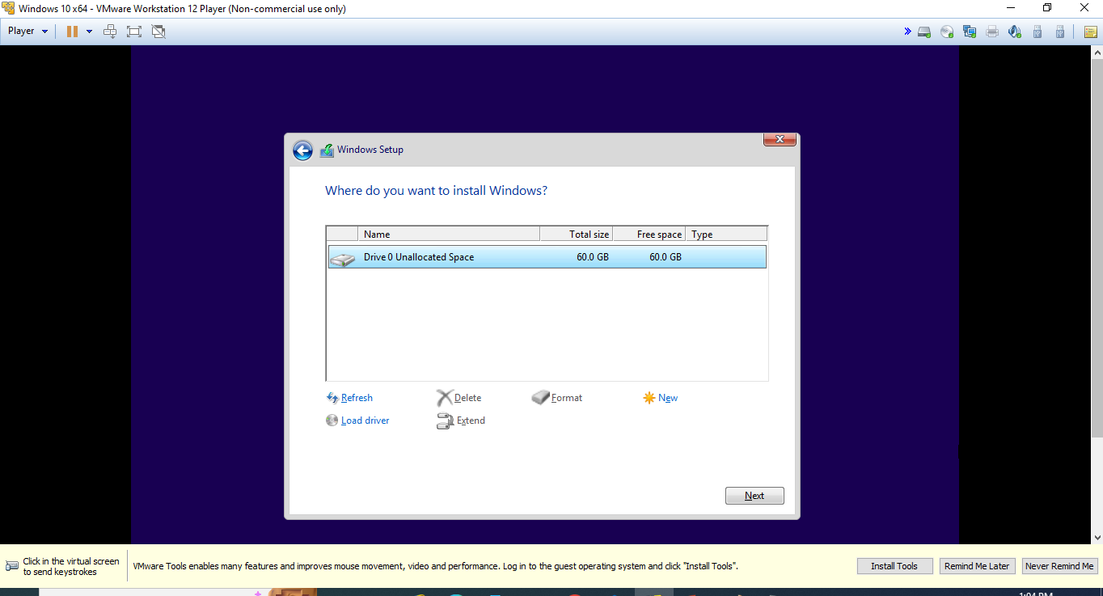
Select disk 0 unallocated space and then click next

Slide 12
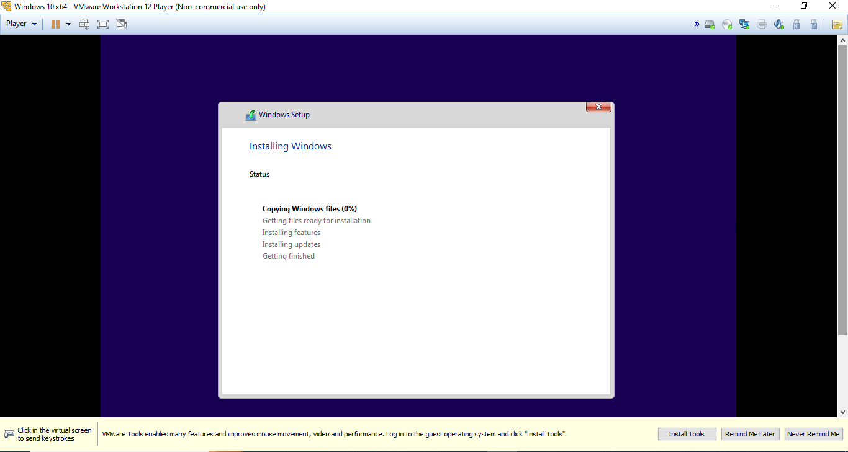
It will take few minutes for windows copying and installation

Slide 13
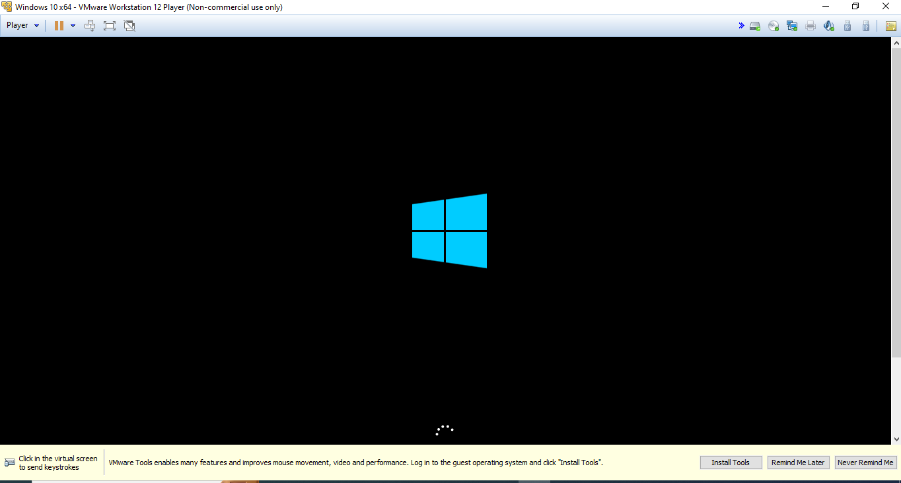
Please wait for few minutes

Slide 14
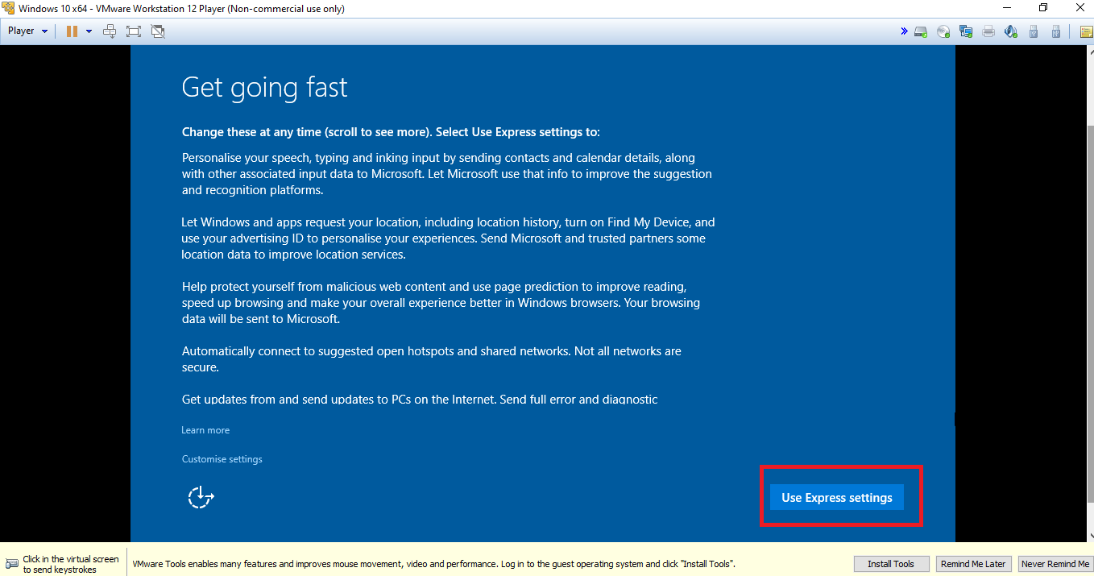
Click on use express settings

Slide 15
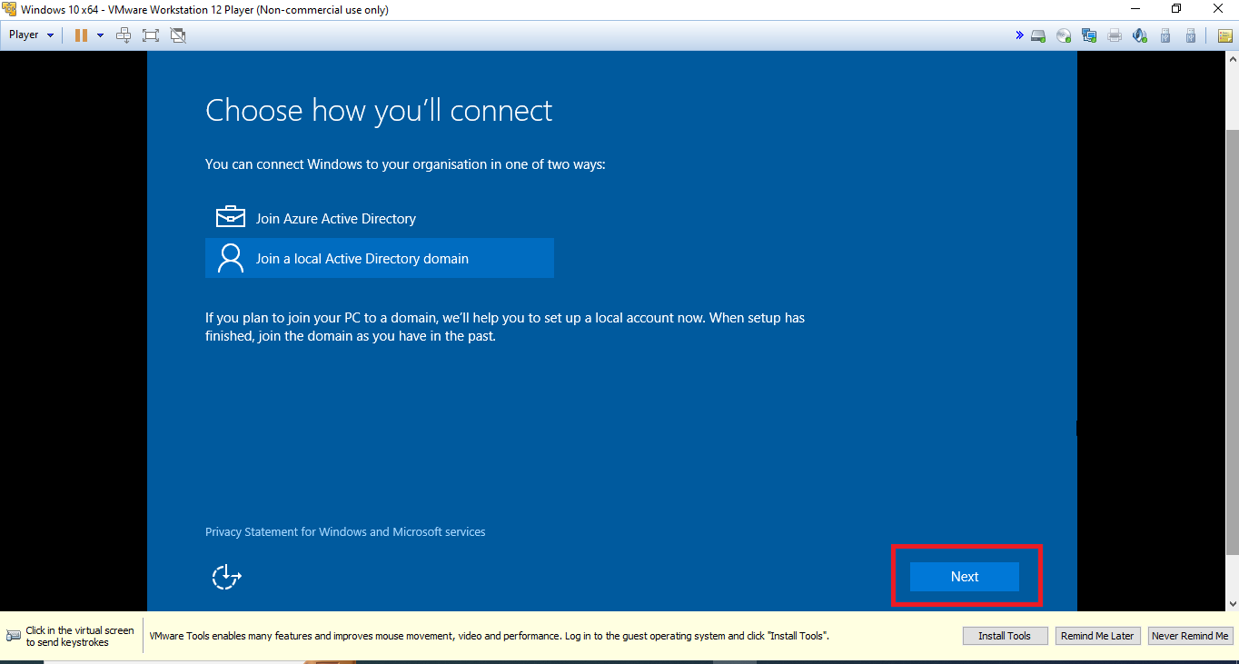
Click on join a local active directory domain and then click next

Slide 16
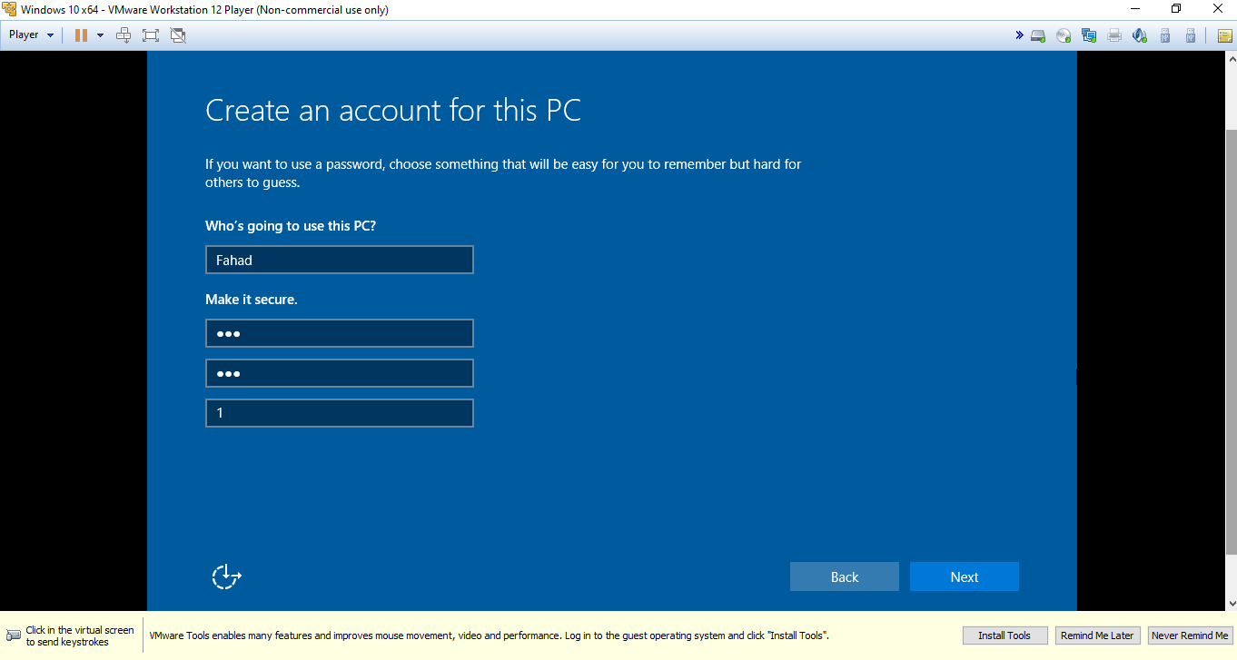
Provide user name and password as you want and then click on next

Slide 17
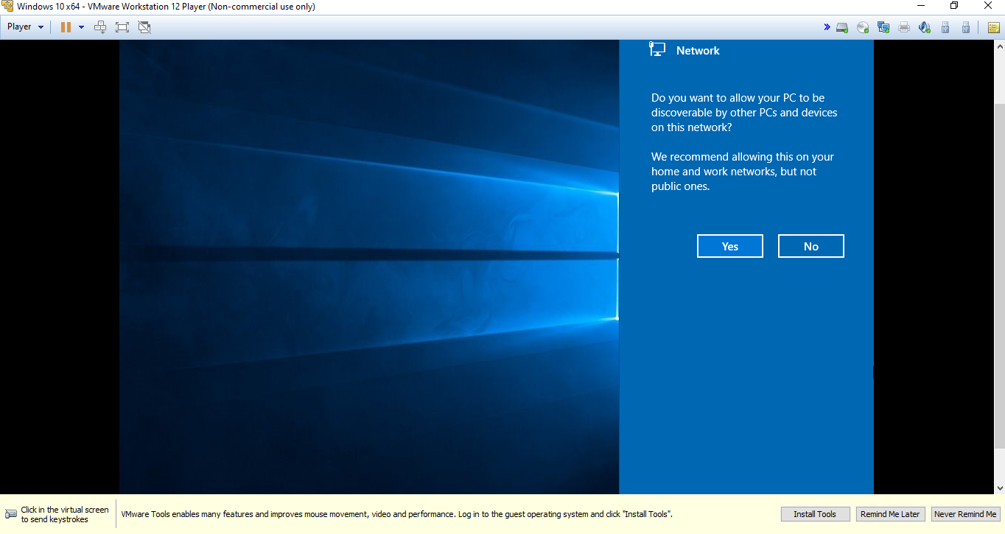
Choose the yes

Slide 18
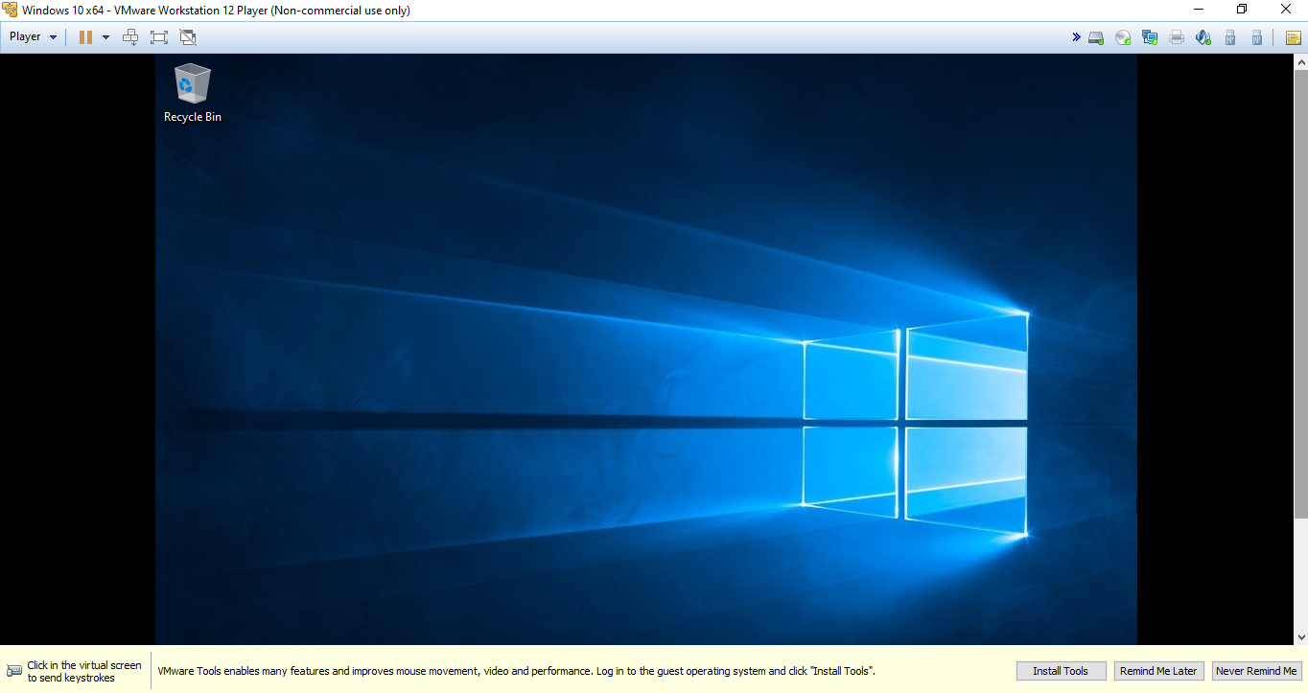
Installation completed successfully

